Slide 1
Syrian Virtual University
ITI-310
Windows Server 2008
Working with Active Directory
Management Tools

Slide 2
Active Directory
Management Tools
  Using Active Directory Domains and trusts Snap-In
  Using Active Directory Site and Services Snap-In
  Using The Active Directory Users and Computers Snap-In.
Eng. Atef Al-Abdullah
١٤٤٨/٠٥/٢٨ 16:26

Slide 3
Domains and trusts Snap-In
  Using Domains & Trust Snap-In
    View all domain trees.
    Configure the UPN suffixes.
    Domain/Forest Operation Mode.
    Manage Trust relationships.
    Change Domain Naming Master.
  Domain and Forest Functionality
    Starting Domain and Trust snap-In
    Add additional UPN suffixes.
Eng. Atef Al-Abdullah
١٤٤٨/٠٥/٢٨ 16:26

Slide 4
Domains and trusts Snap-In
    Changing Domain Function Levels
      Windows Server 2000 Native.
        00/03/08.
      Windows Server 2003.
        03/08.
      Windows Server 2008.
        08.
Eng. Atef Al-Abdullah
١٤٤٨/٠٥/٢٨ 16:26

Slide 5
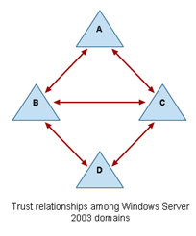
Trust Relationships across Domains
Windows NT trust:
  not transitive
  Not implicitly.
Windows 00/03/08 trust:
  Two-way.
  Transitive.
  Implicitly in forest.
Eng. Atef Al-Abdullah
١٤٤٨/٠٥/٢٨ 16:26

Slide 6
Domains and trusts Snap-In
    Creating Trust.
      Shortcut trusts.
      Realm trusts.
      External Trusts.
      Forest Trusts.
    Accessing Resources in trust relationship
Eng. Atef Al-Abdullah
١٤٤٨/٠٥/٢٨ 16:26

Slide 7
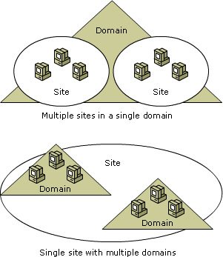
Sites and Services Snap-In
  Definitions
    Sites.
    Sites links.
    Subnets.
  Using Sites
    Replication.
      Intra/Inter sites replication.
    Authentication.
    Control Delegation.
Eng. Atef Al-Abdullah
١٤٤٨/٠٥/٢٨ 16:26

Slide 8
Users and Computers Snap-In
  Starting Users and Computers Snap-In.
  Objects Created In Users and Computers Snap-In
    Organizational Units OUs.
    Contacts.
    Computers.
    Groups.
    Shared Folders.
    Shared Printers.
    Users.
Eng. Atef Al-Abdullah
١٤٤٨/٠٥/٢٨ 16:26

Slide 9
Users and Computers Snap-In
  Creating organizational unit.
  Creating contacts.
  Managing computer object.
  Creating group.
    Group type.
    Group scope.
    Creating group.
    Nested groups.
      Creating nested group.
Eng. Atef Al-Abdullah
١٤٤٨/٠٥/٢٨ 16:26

Slide 10
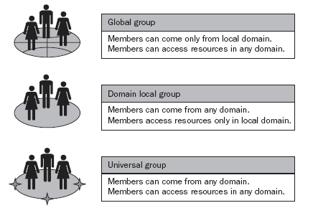
Groups
Types of Groups
  Security Groups.
  Distribution Groups.
Scopes of groups
  Global groups.
  Domain Local Groups.
  Universal Groups.

Slide 11
Users and Computers Snap-In
  Publishing a shared folder.
    Creating the shared folder.
    Publishing the shared folder in the directory.
  Publishing a Printer
    Adding New Printer.
  Renaming, Moving, and deleting Objects
    Renaming.
    Moving.
    Deleting.
  Finding Objects.
Eng. Atef Al-Abdullah
١٤٤٨/٠٥/٢٨ 16:26

